Slide 1
Elec-Go Elec-go means wherever you go electricity is generated
Founders :
Mohammed Hamza
Mohammed Ghouse
Co-Founders :
Mohd Ahsan Uddin
Mahjabeen Fathima Nooreen

Slide 2
Introduction
This presentation covers the concept of energy harvesting from footsteps, its significance, and applications in modern technology.

Slide 3
Overview
In this presentation we student of AIML-b is presenting you a prototype made up of Piezoelectric plates and this device is fixed in the soul of the shoes.

Slide 4
Definition of Energy Harvesting
• Energy harvesting is the process of capturing energy from external sources
• This can be achieved through various methods, including kinetic energy conversion from human movements, such as footsteps.
• The technology allows for self-sustaining systems that do not rely on traditional power sources.

Slide 5
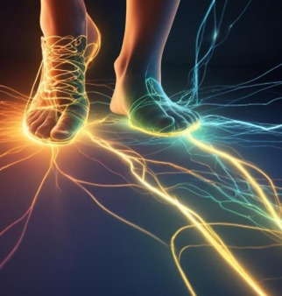
Importance of Footstep Energy
• The energy harvested from footsteps contributes to renewable energy solutions, reducing reliance on fossil fuels.
• It can power small devices, sensors, and lighting in public spaces enhancing sustainability efforts.
• Additionally, integrating footstep energy systems in urban planning promotes eco-friendly infrastructure and raises awareness about energy consumption.

Slide 6
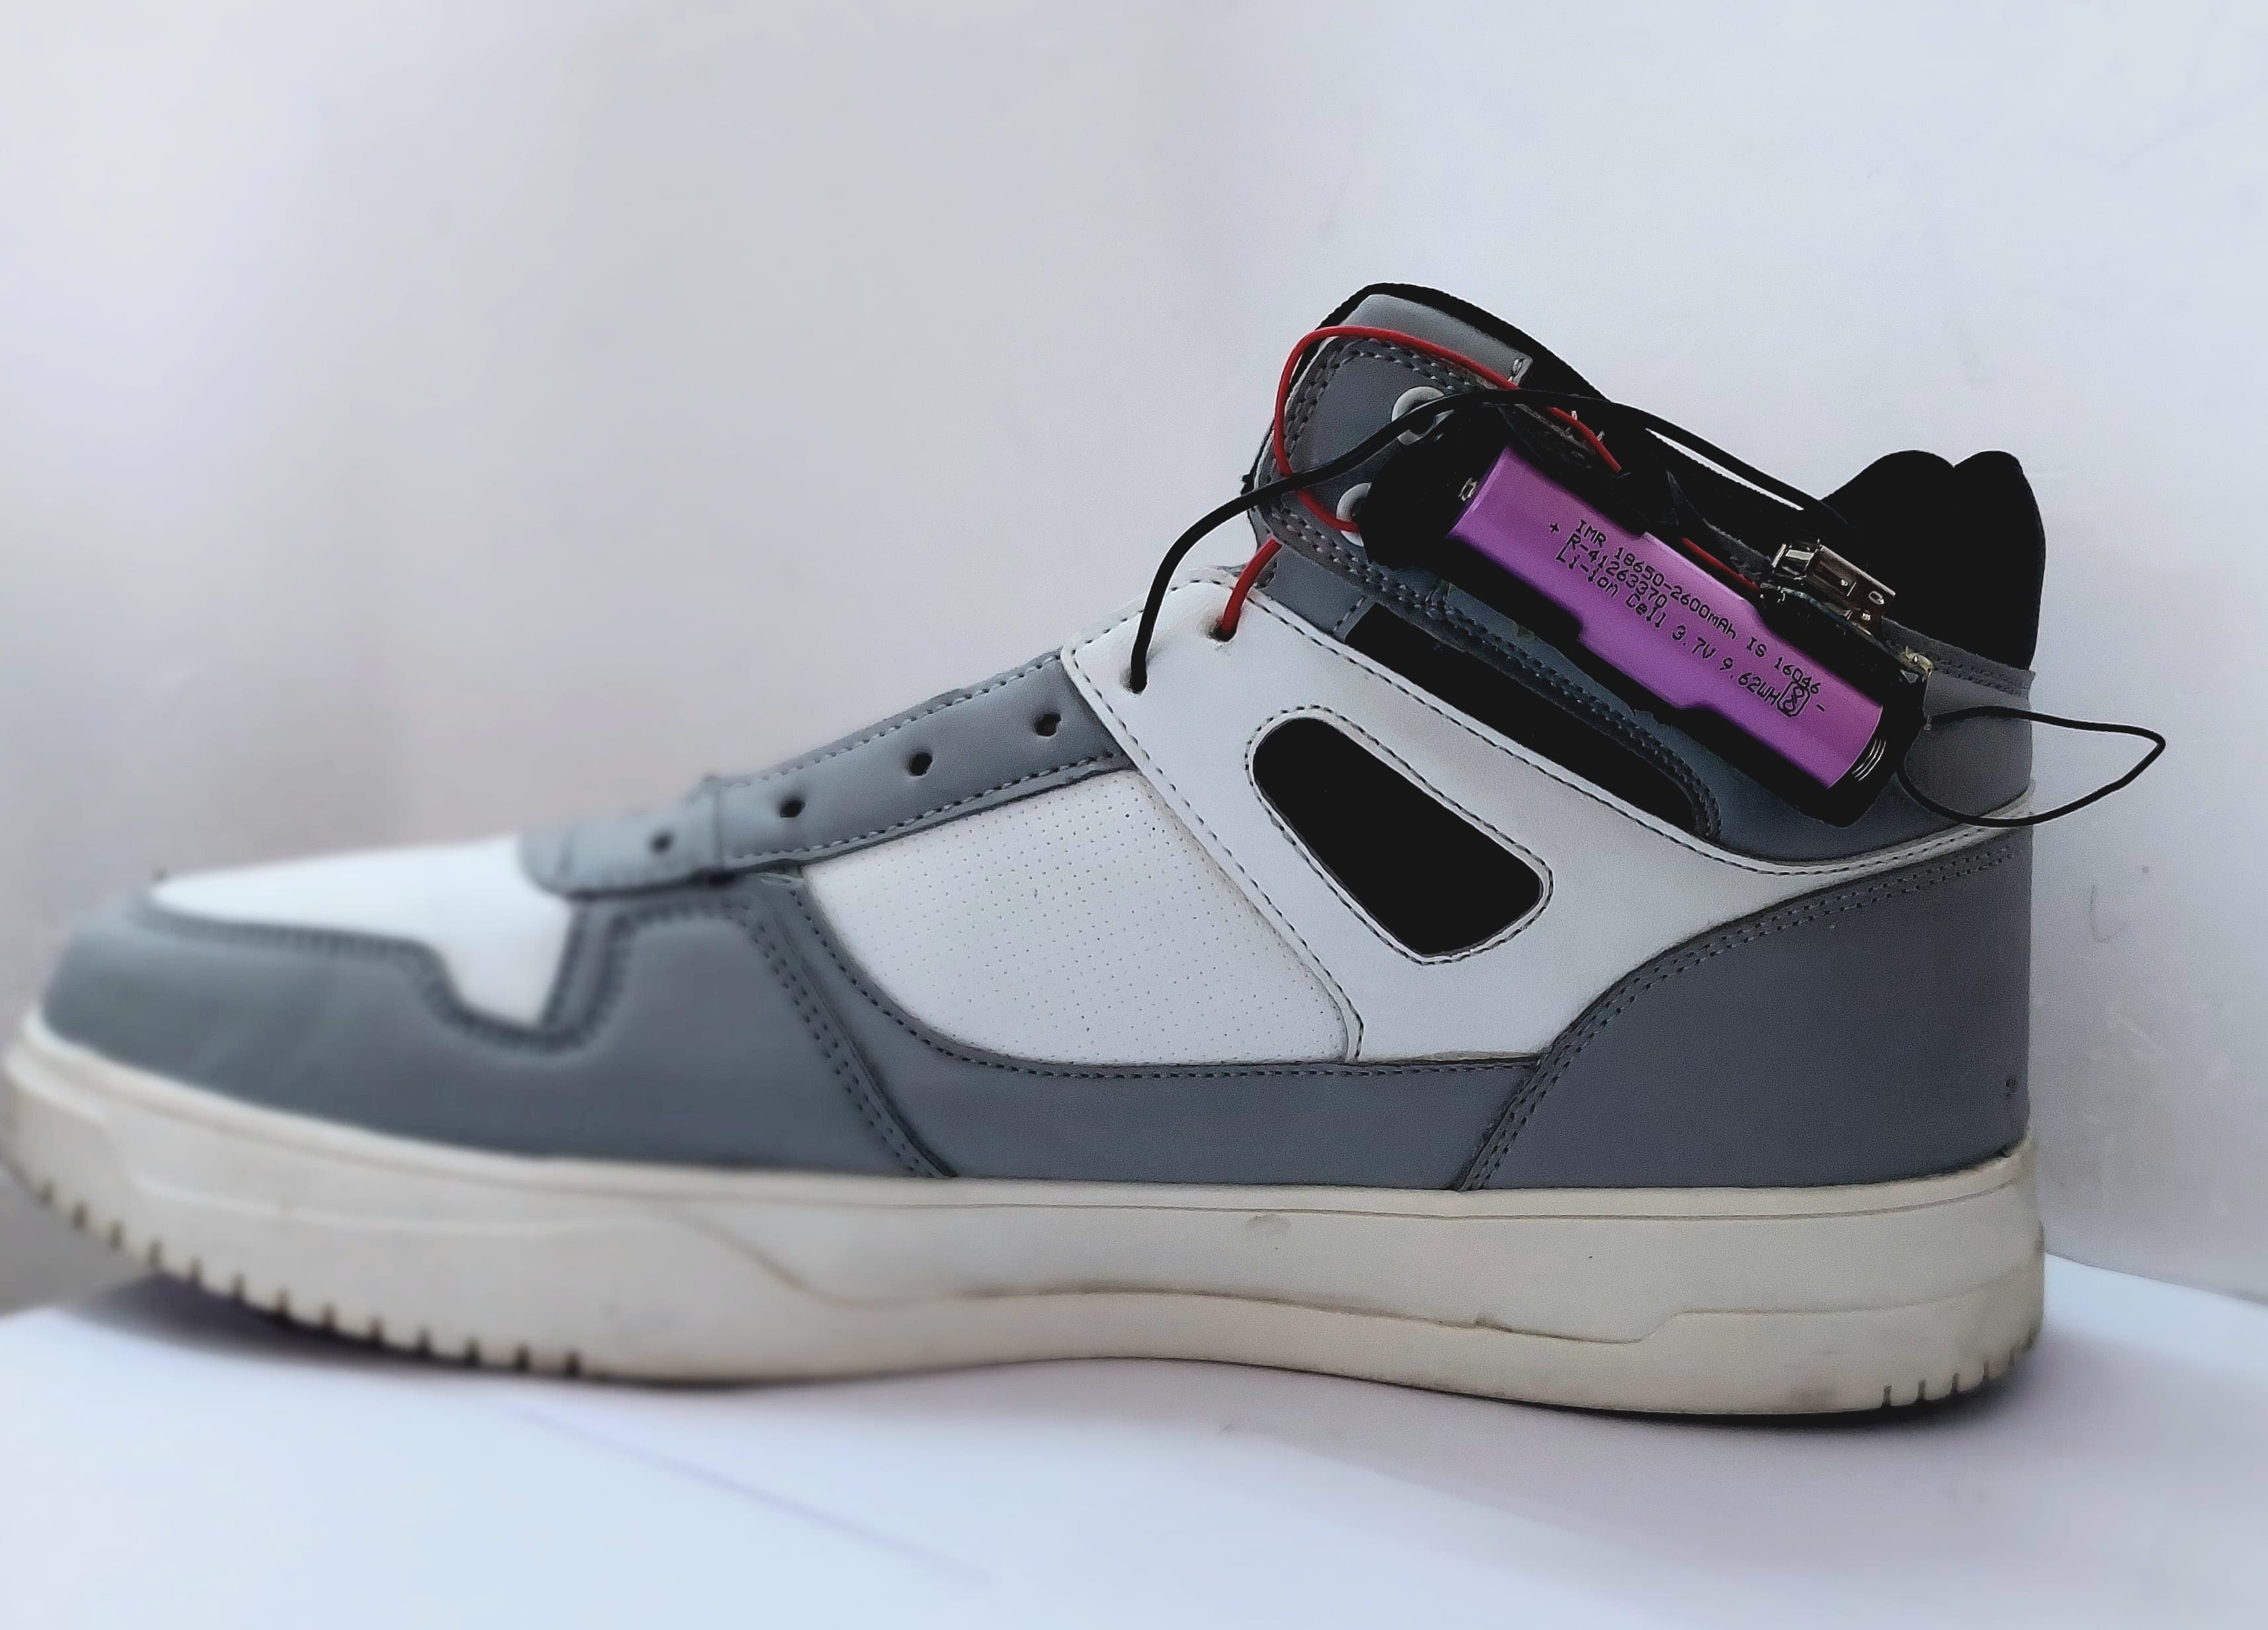
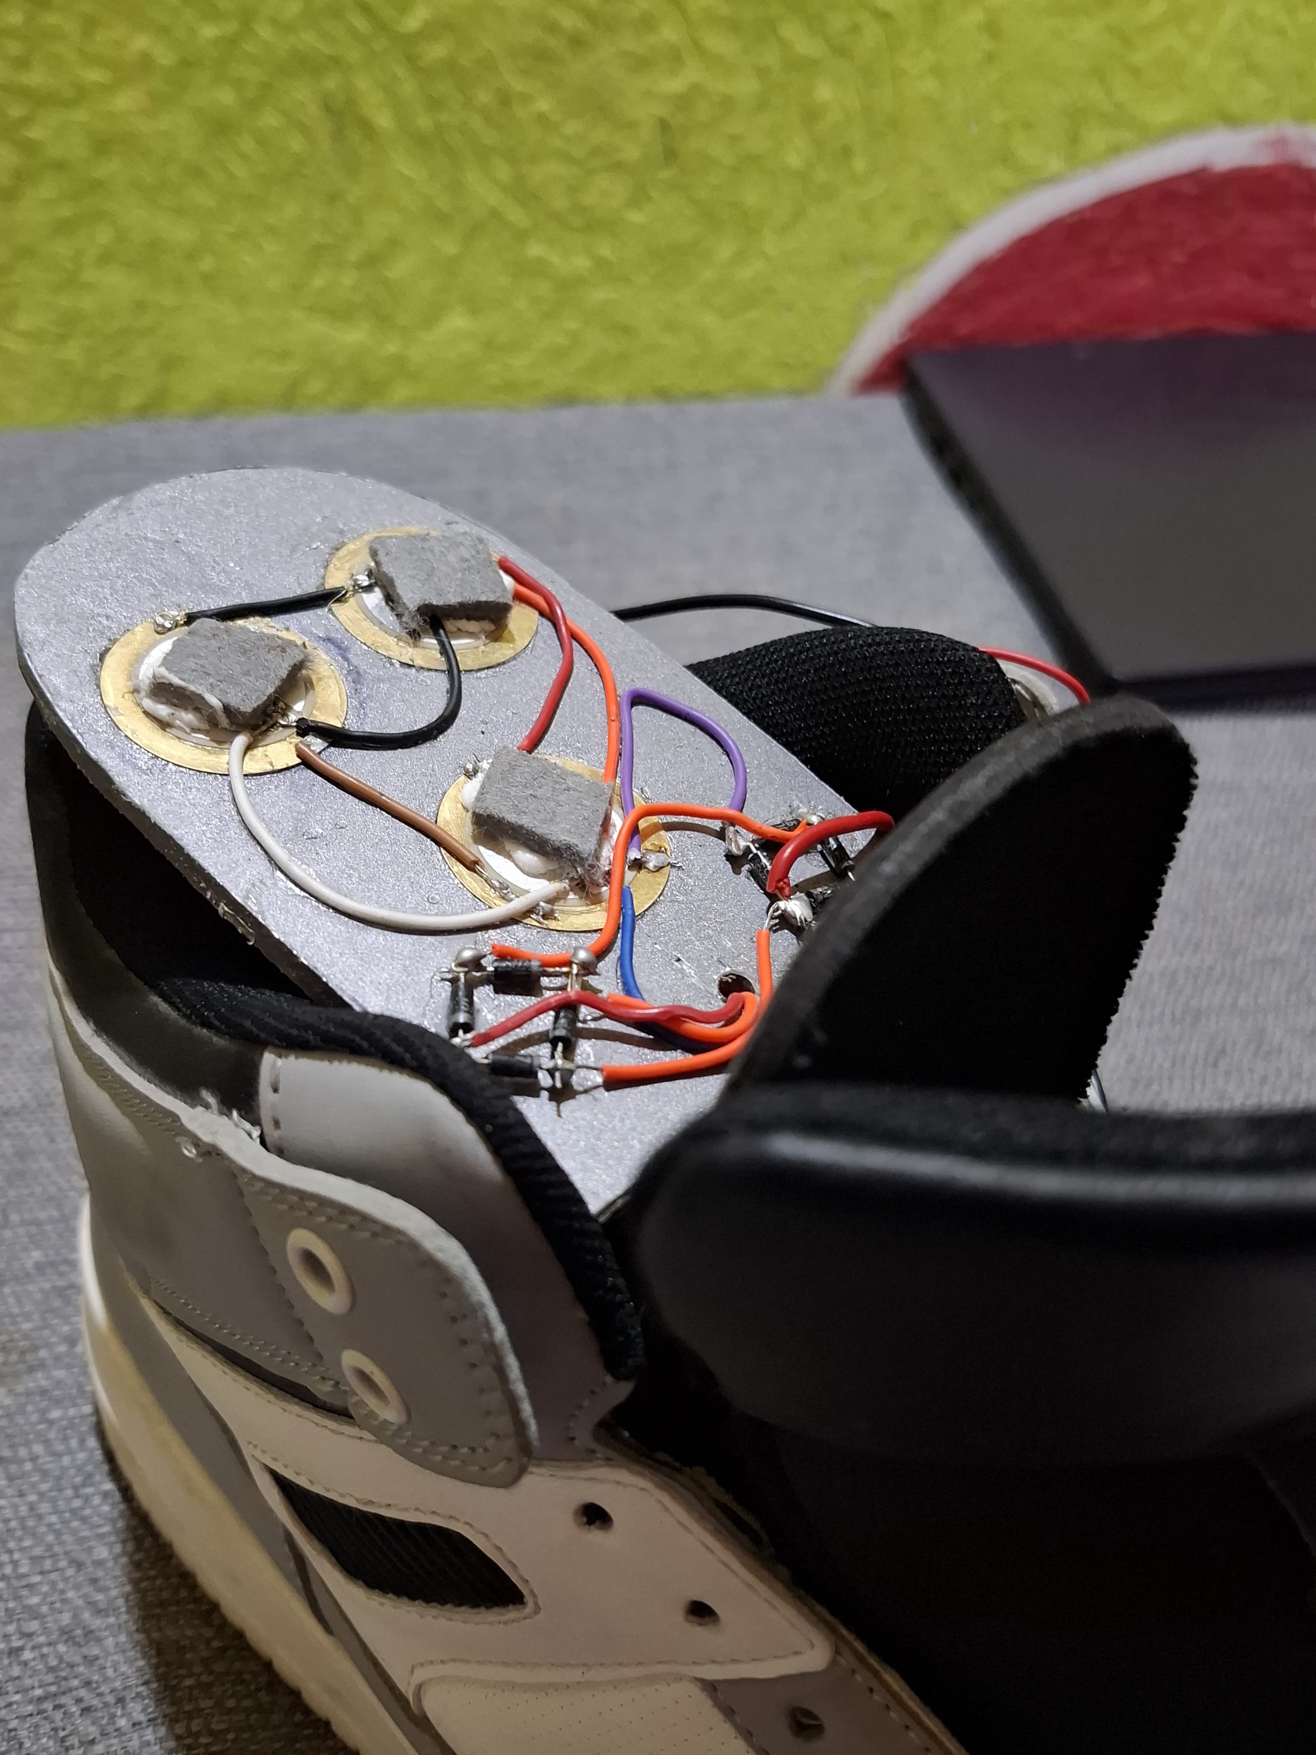
BACK TO OUR PROJECT

Slide 7
Materials Used
Materials
Quantity
Piezoelectric transducers 27mmx6
6
1
N4007 Diode
8
3.7
V Li
-
ion battery
1
USB connector
1
Connecting wires
Required
Shoes(optional)
1

Slide 8

PIEZOELECTRIC SENSEORS
A piezoelectric sensor is a device that generates an electrical charge in response to applied mechanical stress. It utilizes the piezoelectric effect, where certain materials (such as quartz, ceramics, or polymers) produce voltage when subjected to pressure, vibration, or strain.
Working Principle of Piezoelectric Sensors
Mechanical Force Applied: External pressure, vibration, or strain is applied to the sensor.
Piezoelectric Effect: The piezoelectric material inside the sensor converts the mechanical force into an electrical charge.
Signal Processing: The generated voltage is processed and used for measurement or control.

Slide 9
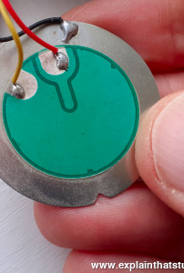
Applications of Piezoelectric Sensors
Industrial: Vibration monitoring in machines, structural health
monitoring.
Medical: Ultrasonic imaging, heartbeat monitoring.
Automotive: Knock sensors in engines, airbag deployment sensors.
Consumer Electronics: Touchscreens, microphones, and speakers.
Aerospace: Structural monitoring of aircraft components.

Slide 10
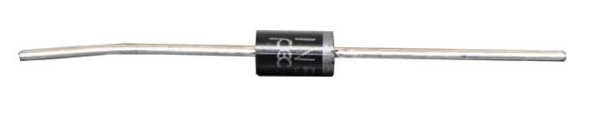
Over view of 1N4007 Diode
The 1N4007 is a commonly used rectifier diode in power applications. Here are its key specifications:
Type: General-purpose rectifier diode Maximum Voltage: 1000V Maximum Current: 1A
Forward Voltage Drop: ~0.7V
Reverse Recovery Time: Slow (suitable for low-frequency applications)
Applications
AC to DC rectification (e.g., power supplies)
Protection circuits (e.g., flyback diodes in relays)
Voltage blocking in DC circuits

Slide 11
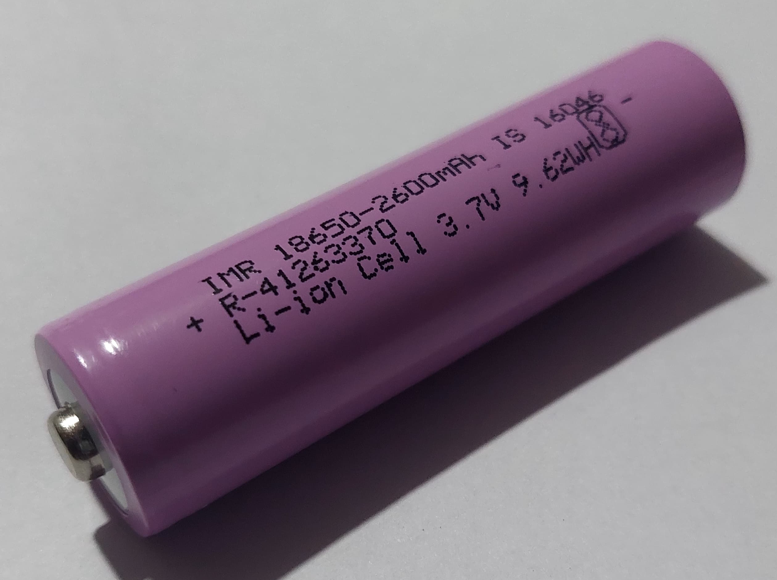
Over view of Lithium-Ion battery
A 3.7V Li-ion (Lithium-Ion) battery is a rechargeable battery commonly used in
electronics such as smartphones, laptops, power banks, and IoT devices.
Charging a 3.7V Li-ion Battery
Never charge above 4.2V (risk of explosion or fire).
Best Charging Method: Constant Current / Constant Voltage (CC/CV). Recommended Charger: TP4056 (for small Li-ion batteries).
Charging Current: 0.5C to 1C (e.g., for a 2000mAh battery, charge at 1A max).
Applications
Smartphones
tablets
laptops
Power banksDrones & RC toysWearable devices (smartwatches, fitness bands)
LED lights & flashlights

Slide 12
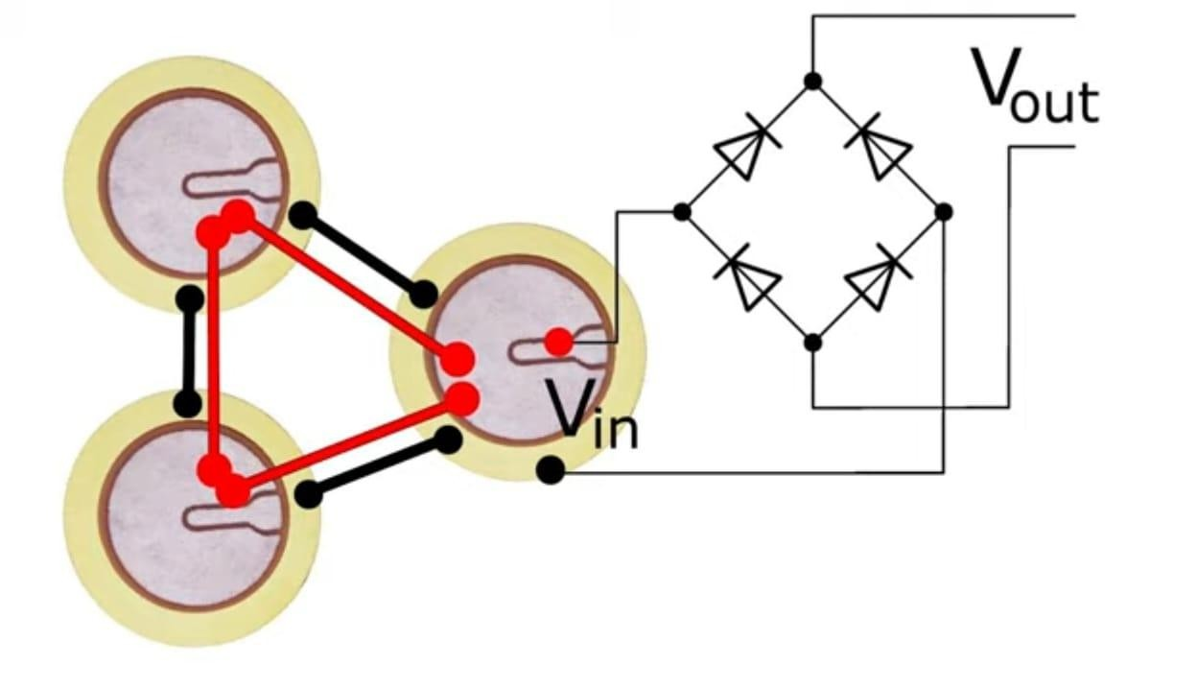
Circuit

Slide 13

Advantages & Disadvantages of Piezoelectric Sensors
Advantages | Disadvantages
High sensitivity to small forces | Cannot measure static forces (only dynamic changes)
No external power required | Requires signal conditioning (amplifiers, filters)
Fast response time | Fragile in some cases
Compact and durable | ----------

Slide 14
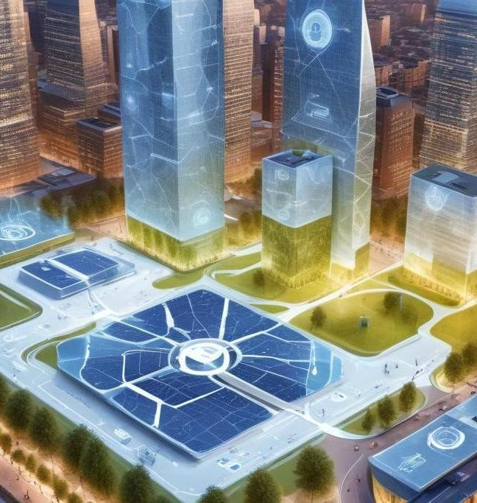
CONCLUSION
Footstep energy harvesting presents a revolutionary approach to energy generation in urban environments. This technology offers sustainable solutions for powering small devices and systems while promoting renewable energy. As technologies advance and awareness increases, the integration of footstep energy harvesting will likely expand, leading to more innovative applications in everyday life.

Slide 15
Thank you

